Slide 1
Crime: Myths and Realities
Workshop 1: Module Introduction
Notes:
Intro and ice breaker- 20 mins
Conspiracy theories- 15 mins
Snopes task -15 mins
Conclusion/End 5 mins

Slide 2
Workshop Learning Outcomes
This workshop has three main intended outcomes. By the end you should…
Know each other a bit better!
Have an understanding of key issues related to starting university.
Have an understanding of conspiracy theories, fake news and the dangers these pose to society.

Slide 3
Firstly…
Did everyone manage to attend the lectures for this week?
Just to check is everyone has access to the Blackboard site for this module?
This is where you access lecture slides, reading lists and other relevant material.
If you do not have BlackBoard access yet, this may be an enrolment issue so please contact Ask4Help asap. Unfortunately, academic staff cannot help with enrolment, IT or timetabling issues.

Slide 4
Reminder: Content Warning
This module will discuss various sensitive topics which some students might find distressing. These includes topics like, murder, rape, and sexual assault. At times we may discuss unpleasant details relating to specific criminal cases.
Because criminology focusses on crime and harm, it is impossible to study the topic without encountering difficult topics. The nature of criminology means that a most modules are likely to touch upon discuss difficult topics at certain times, but rest assured these will always be dealt with sensitively.
If you have any concerns, please feel free to contact Nathan (the module leader), your personal tutor or another member of staff who will be able to signpost you to support.
Below are some useful links relating to support that the university can offer:
General support: https://www.northumbria.ac.uk/study-at-northumbria/support-for-students/student-life-and-wellbeing/
For support around mental health: https://www.northumbria.ac.uk/study-at-northumbria/support-for-students/counselling-and-mental-health-support
For urgent support: http://www.northumbria.ac.uk/needhelpnow

Slide 5

Ice breaker! (10-15 mins)
In pairs:
Two truths and a lie!
Tell your neighbour two true things and one fake thing about themself. Your neighbour will do the same. You should each then try and figure out which one the lie.
Notes:
Workshop leaders are welcome to offer the group two truths and a lie about themselves before the task in order to give them an idea of what to do. You can reveal your lie after the task.

Slide 6

Conspiracy Theories

Slide 7
Conspiracy Theories
In the lectures we talked about the complexity of the truth, and about avoiding myths. We touched upon ‘conspiracy theories’ as a key problem today.
Cassam (2019) argues that Conspiracy Theories are not simply theories about conspiracies- as there have been many well documented conspiracies through history that are proven real.
e.g. Believing in Guy Fawkes’ conspiracy to blow up parliament does not make someone a conspiracy theorist.
Instead, he argues ‘Conspiracy Theories’ (capital C, capital T) are speculative, amateurish, contrarian, esoteric and reflect premodern thinking (e.g. complex events are able to be controlled by a small number of people acting in secret).
They often, but not always, serve to promote a political agenda:
e.g. holocaust denial- exonerates the Nazis and attempts to smear Jewish people.

Slide 8
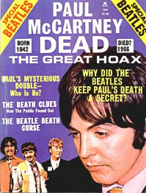

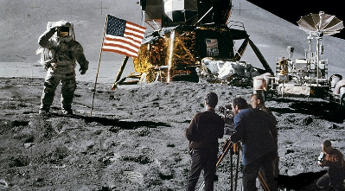

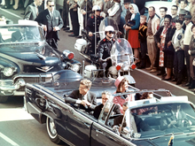

Conspiracy theories activity: WHAT IS THE CONSPIRACY AND WHAT EVIDENCE IS THERE? (20mins)
In pairs, use your preexisting knowledge as well as your phones to find out and discuss the following conspiracy theories. Be prepared to discuss what you find with the wider group.
1
2
3
If you don’t have a phone with internet, please work with someone who does.
4
5
6
Notes:
Feeding Back
9/11 conspiracy
Moon landing conspiracy
Paul is Dead Beatles conspiracy (people believe he died and was replaced)
Covid 5G conspiracy
Avril Lavigne conspiracy (people believe she died and was replaced- similar to Paul)
JFK conspiracy

Slide 9
Which resources did you use?
Newspapers
Wikipedia
Official websites
University library
Other
Some are better than others, and we’ll come back to the ‘hierarchy’ of sources next week.

Slide 10
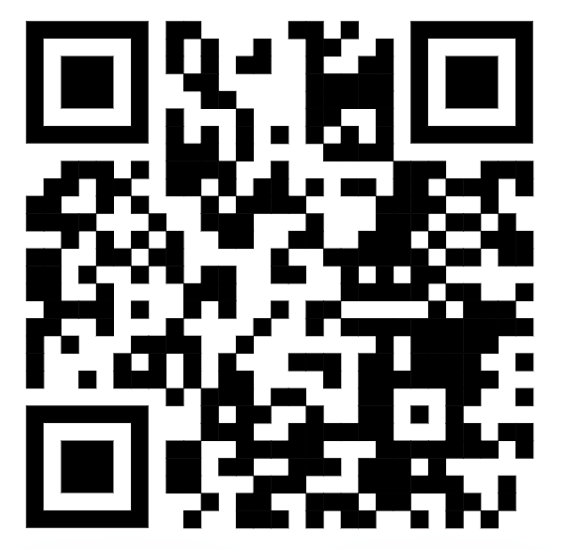
ACTIVITY: Snopes.com (15 mins)
In small groups, use your phones to visit Snopes.com and find an example of a ‘debunked’ story.
Make notes on the key details and be prepared to share the story with the wider group when asked.
What can we learn from the example you found?
www.snopes.com QR code

Slide 11
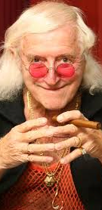
Conspiracy Theories and the Truth
There are numerous baseless conspiracy theories relating to child sexual abuse (for example, theso-called ‘Pizzagate’ conspiracy) and we need to be highly critical of these.
However, part of the problem is that child-sex rings and human trafficking do exist.
And more to the point recent evidence shows that cover-ups do happen:
Lambeth Council ‘culture of cover-up’ led to more than 700 children in South London care homes suffering cruelty and sexual abuse https://www.bbc.co.uk/news/uk-57984924
Also, cases in the Catholic Church, and the Jimmy Savile case- which we will discuss later in the module.

Slide 12
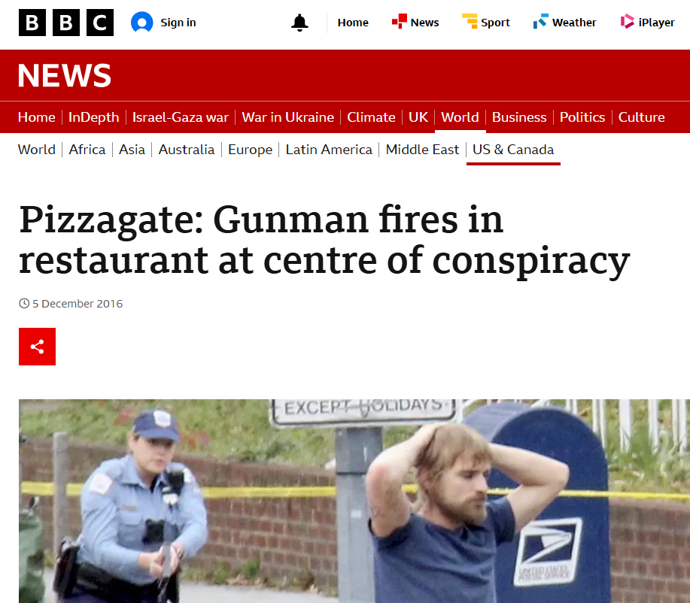
Conspiracy Theories and the Truth
In contrast to real cases discussed on the last slide, ‘conspiracy theories’ like Pizzagate lack any shred of evidence, least of all the testimony of any actual victim, and perpetuating them risks people’s lives and does a disservice to the people who really are suffering this kind of abuse.
This is why credible evidence is so, so, important!

Slide 13
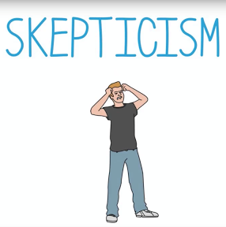
So, can we ever be too skeptical?
Being skeptical about what we are told is very important!
Be critical, don’t just accept what I or anyone else tells you!
The important thing is to use evidence to support your views, and to know the value of evidence.
How it is produced? How it can be used and manipulated?
Often real ‘miscarriages of justice’ are initially dismissed as ‘conspiracy theories’!
We’ll come back to this later in the module…

Slide 14

Conclusion: Multiple Truths?
This module is designed to equip you with the skills to become a credible, critically minded criminologist.
Navigating the truth can be complex. There aren’t always ‘correct’ answers.
We need to be sceptical, but we also need to be able to identify which sources of evidence are credible and which are not.
Next week we will begin to examine how we might go about doing that and building credibility for ourselves.
Any questions???

